Slide 1


IBM University Engagement Project Submission
“Exploring the Power of Agentic AI with IBM Granite and Lang Flow”
KhedutMitra AI — AI-Powered Cotton & Groundnut Market Linkage Platform
LET’S
START

Slide 2
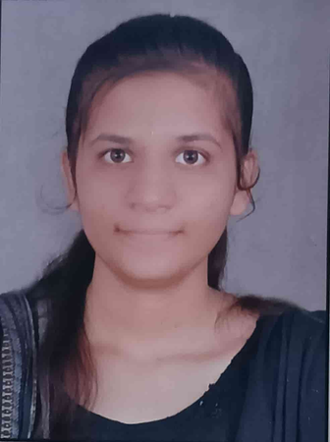

Domain of Project: Agriculture / AgriTech
Project Title: KhedutMitra AI — AI-Powered Cotton & Groundnut Market Linkage Platform
Student’s Name | Recent Passport Photo | Email Id | Mobile Number
Singhaniya Kasak P |  | kasaksinghaniya5@gmail.com | 8799610059
Bhatiya Drashti K. |  | bhatiagrishti@gmail.com | 9427844354

Slide 3
Problem Statement
Problem Statement: AI-Powered Cotton & Groundnut Market Linkage Platform
The Challenge Gujarat is a leading producer of cotton and groundnut, yet farmers routinely lose income to middlemen, lack access to real-time mandi prices, and have no direct channel to buyers. Storage and selling decisions are made on guesswork, not data — costing farmers 15–30% of potential earnings every season.
The Objective Build an Agentic AI platform that gives farmers real-time price intelligence, direct market linkages, and data-backed selling/storage decisions. The solution should:
Real-Time Price Intelligence — Forecast mandi prices (7/15/30-day) with clear reasoning.
Direct Buyer-Farmer Matching — Rank verified buyers by price, distance, and reliability — no middleman.
Storage vs. Sell Advisory — Recommend the optimal timing to maximize returns.
Quality Grading Assistance — Standardize lot grading (FAQ/A/B/C) for fair pricing.
Multi-Agent System — Price Forecast Agent, Buyer Matching Agent, Storage Advisor Agent, Quality Grading Agent, Income Dashboard Agent — orchestrated together.
Income Dashboard — Track season-over-season earnings vs. mandi averages.
´

Slide 4
Proposed Solution
AI-Powered Cotton & Groundnut Market Linkage Platform
Multi-agent Agentic AI system built on IBM Granite LLM + watsonx.ai, with a FastAPI + React stack — bringing farmers the same market intelligence large traders already have.
Price Forecast Agent — Analyzes historical mandi data to project short-term price trends and explains the key drivers behind them.
Buyer Matching Agent — Connects farmers directly to verified buyers, ranked by price, distance, and reliability; generates negotiation talking points.
Storage Advisor Agent — Weighs storage cost vs. expected price gain to recommend sell-now vs. store-and-wait.
Quality Grading Agent — Estimates produce grade (FAQ/A/B/C) to support fair, standardized pricing.
Income Dashboard Agent — Tracks farmer earnings against the mandi average over the season.
Orchestrator Agent — Routes farmer queries to the right specialist agent, so a simple question like "Should I sell my cotton today?" gets a complete, reasoned answer.
IBM Granite powers reasoning & explanations; watsonx.ai ensures scalable deployment and governance; architecture is designed to plug into live Agmarknet/eNAM data in production.

Slide 5
Technology Used
LangFlow — Visual design & orchestration of the multi-agent workflow
IBM Granite Model (ibm/granite-3-8b-instruct) — Reasoning, forecasting explanations, personalization
IBM watsonx.ai — Model deployment, embeddings, AI governance
IBM Cloud — Scalable, secure infrastructure for deployment
RAG (Retrieval-Augmented Generation) — Grounds price/quality answers in real mandi data before generation
FastAPI — Backend orchestration layer for all agents
React.js — Farmer/buyer-facing dashboard and chat interface
Vector Database (FAISS/Chroma) — Retrieval of historical price & buyer data

Slide 6
Langflow component Used
Chat Input — Farmer enters query (crop, quantity, location, question)
IBM watsonx AI Agent — Processes input via Granite to generate forecasts/recommendations
IBM Granite Model — Granite-3-8B-Instruct → fast, real-time reasoning for price & storage advice
Chat Output — Displays price forecasts, buyer matches, and storage advice
File Component — Loads mandi price history, buyer registry, and farmer transaction logs
Orchestrator/Router Component — Directs multi-intent farmer queries to the correct specialist agent

Slide 7
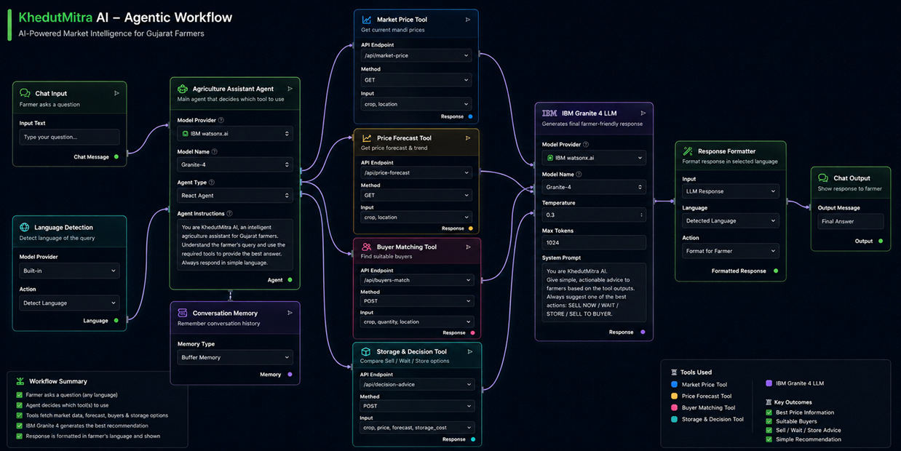
Langflow workflow

Slide 8
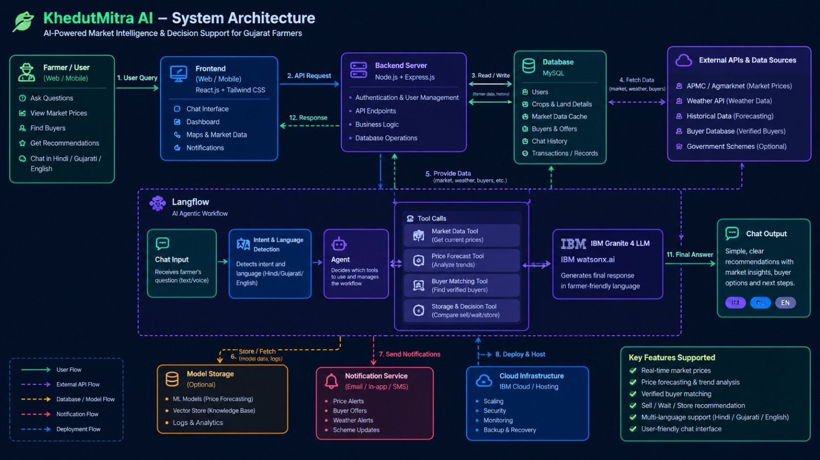
Architecture Blueprint

Slide 9
Role of Agentic AI in the solution
Role of Agentic AI in the Solution:
Agentic AI turns KhedutMitra AI from a static price-lookup tool into an autonomous decision-support system for farmers.
Powered by IBM watsonx.ai and Granite models, coordinating five specialized agents — each handling a distinct task: forecasting prices, matching buyers, advising on storage, grading quality, and tracking income.
Context Awareness — Understands the farmer's crop, location, and quantity to tailor every recommendation.
Real-Time Adaptation — Continuously updates advice as mandi prices shift.
Inter-Agent Collaboration — e.g., the Storage Advisor consults the Price Forecast Agent before recommending a wait period.
The result: a proactive market advisor, not a reactive chatbot — one that actively helps farmers time their sale and reach the right buyer for maximum income.

Slide 10
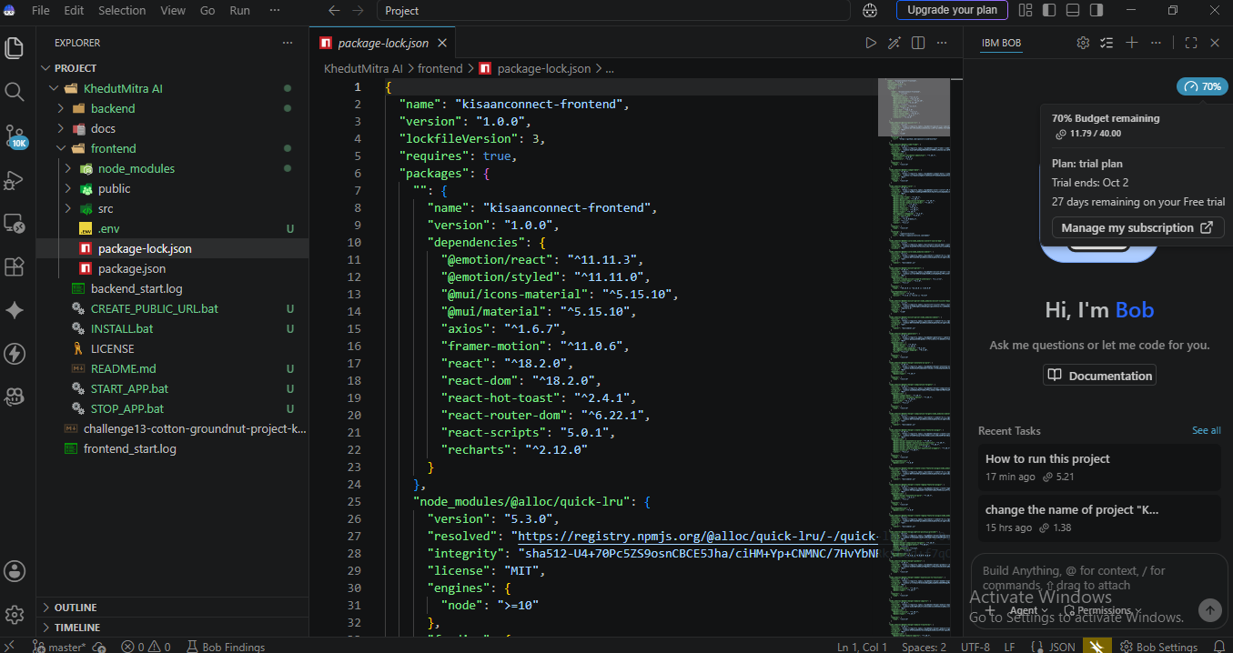
Token Usage

Slide 11
Novelty & Uniqueness
Multi-Agent Intelligence — Five specialized agents collaborate instead of one generic chatbot.
RAG-Grounded Price Accuracy — Forecasts and grading are grounded in real mandi/buyer data, not hallucinated numbers.
Direct Market Linkage — Goes beyond advice to actually connect farmers with ranked, verified buyers — eliminating the middleman.
Storage Economics Built In — Explicitly models the cost/benefit of waiting vs. selling now, something no existing mandi app does.
Negotiation Support — Generates ready-to-use negotiation starters, boosting farmer bargaining power.
Regional Focus, National Potential — Purpose-built for Gujarat's cotton & groundnut belt, but architecture generalizes to any crop/mandi.
Enterprise-Grade Foundation — Built on IBM watsonx.ai and Granite, ready to scale from prototype to production with governance built in.
This makes KhedutMitra AI a complete market-linkage ecosystem, not just another price-checking app.

Slide 12
GitHub Link
Repository: https://github.com/drashti-bhatia/KhedutMitra-AI---IBM---Challenge-13-AI-Powered-Cotton-Groundnut-Market-Linkage-Platform
Checklist before submission:
app.json file uploaded
Problem statement PDF uploaded
Project presentation (.pptx) uploaded
Any other supporting files uploaded

Slide 13
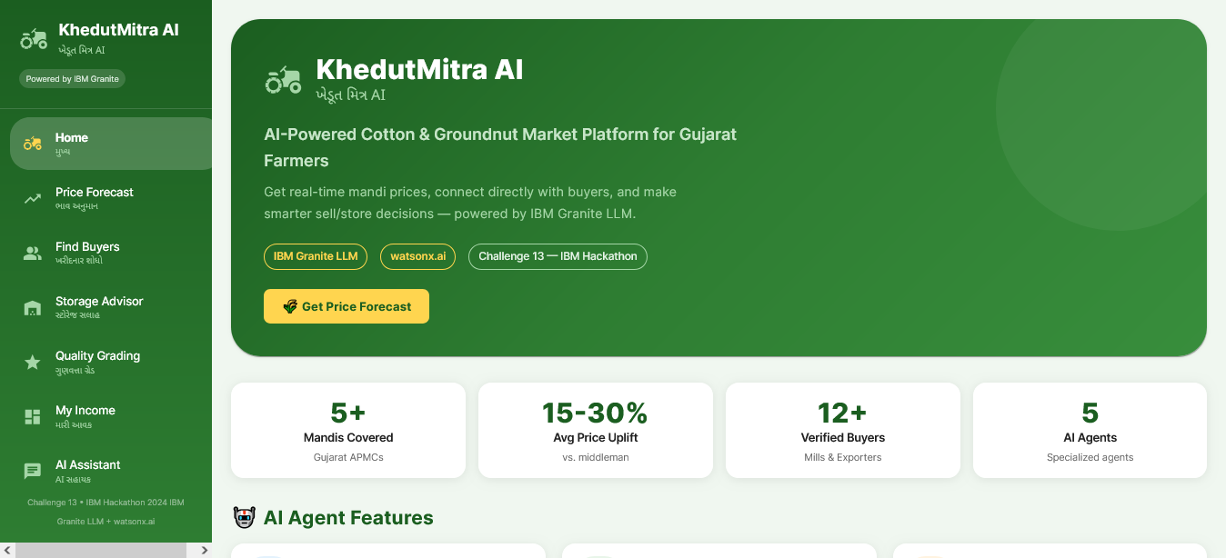
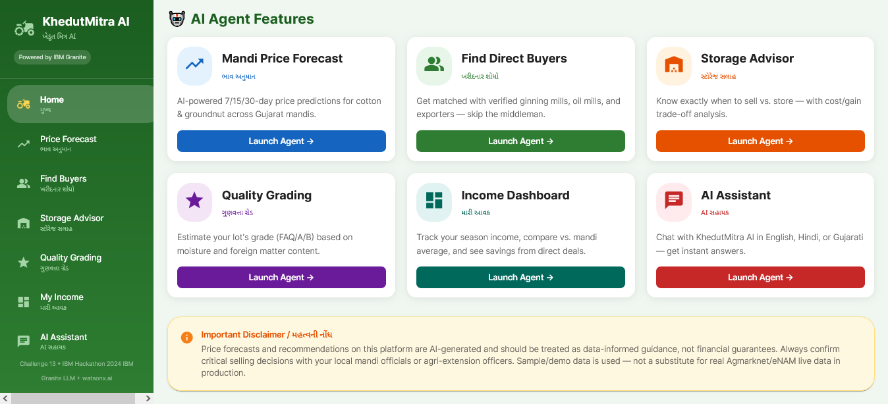
Dashboard
Home screen showing the KhedutMitra AI logo, tagline, and key stats
Grid of six AI Agent Feature cards

Slide 14
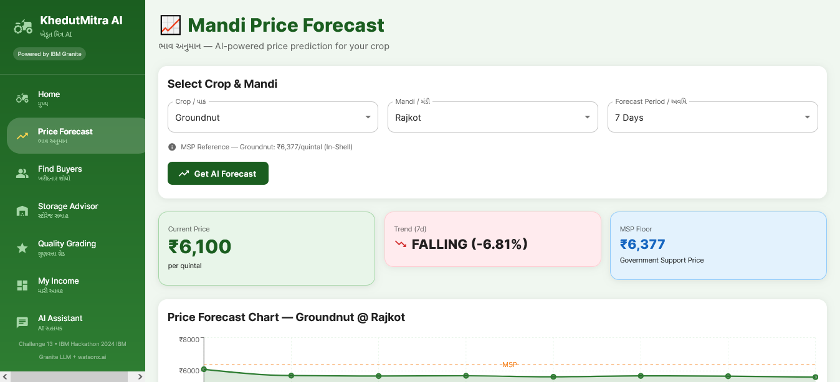
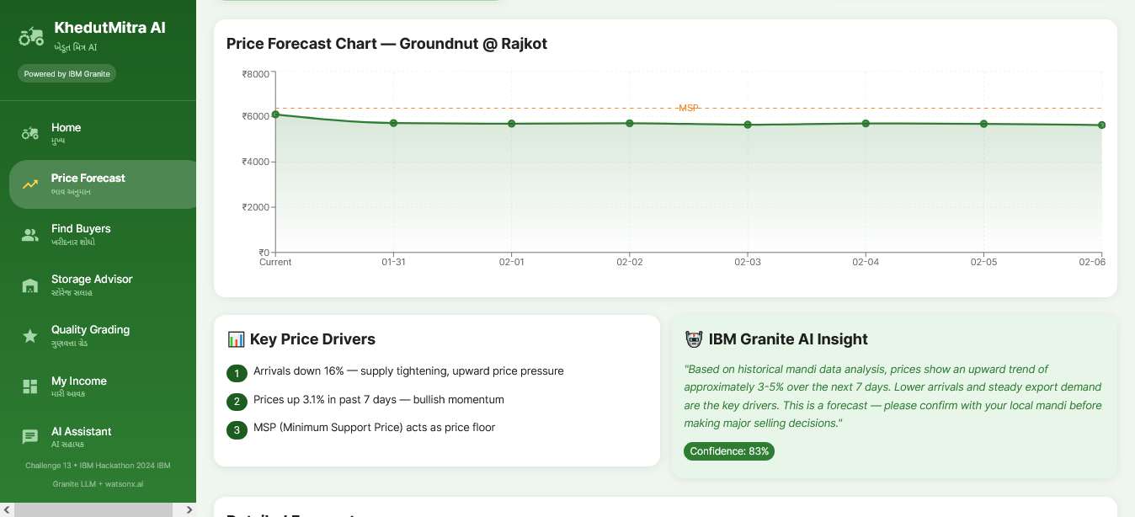
Price Forecasting
Crop/mandi selection form showing current price
Price forecast line chart with Key Price Drivers and an IBM Granite AI insight explaining the trend.

Slide 15
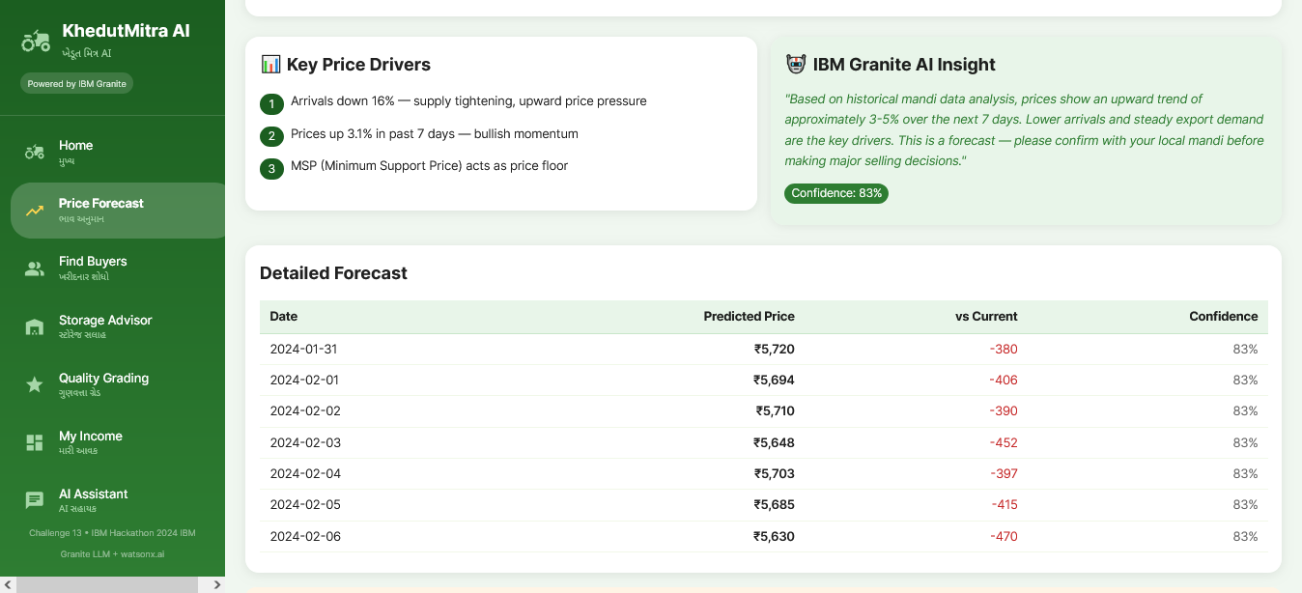
Price Forecasting
Detailed day-by-day forecast table showing predicted price, change vs. current, and confidence score.

Slide 16
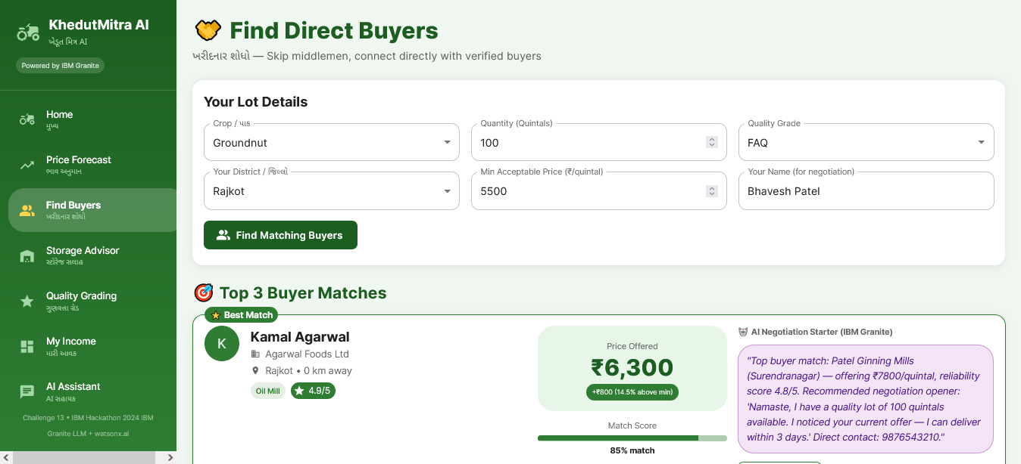
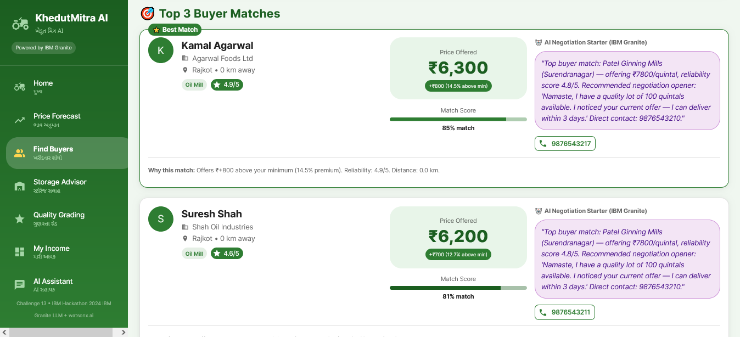
Find Buyers
Buyer-matching input form (crop, quantity, grade, min price) with the "Find Matching Buyers" action.
Ranked buyer match cards showing offered price, match score, and an AI-generated negotiation opener.

Slide 17
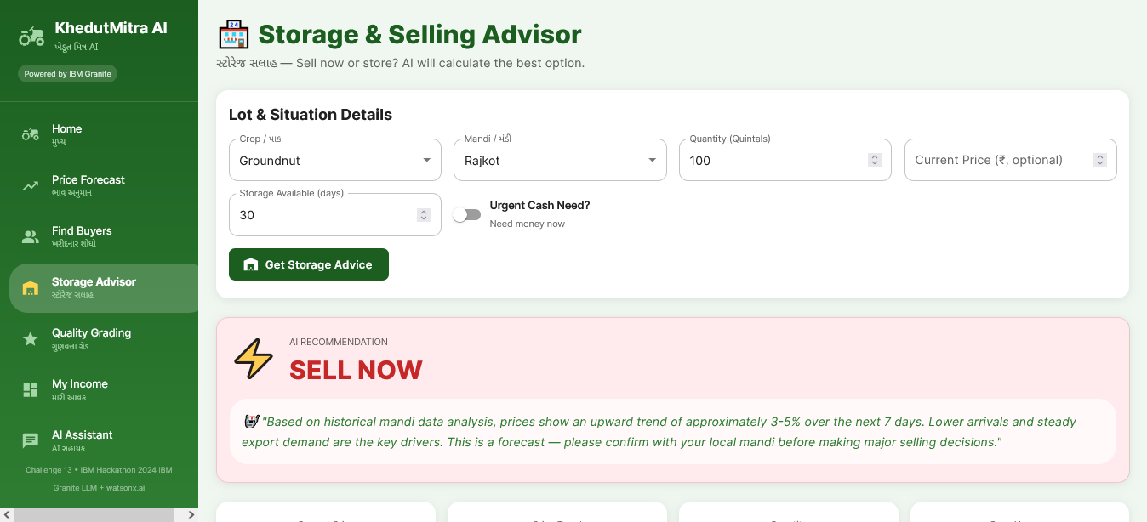
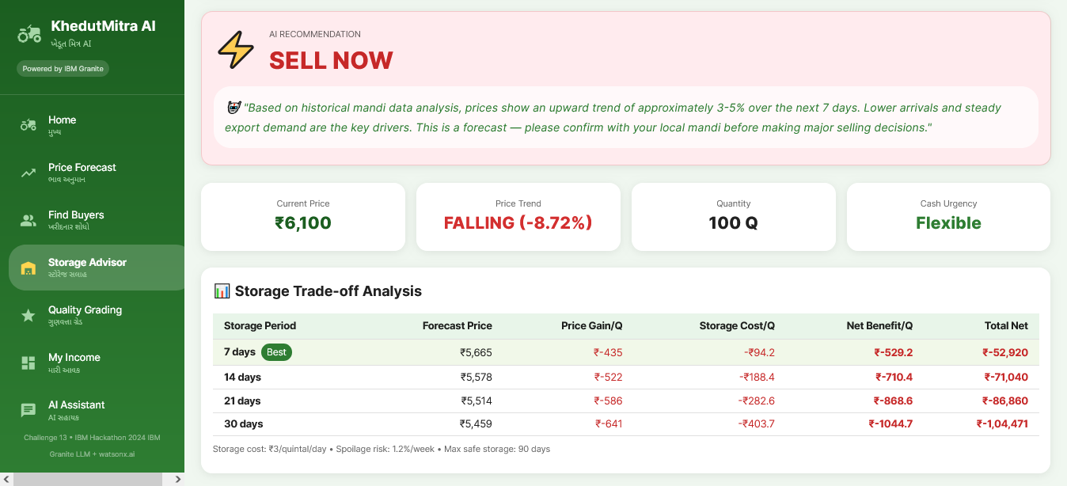
Storage Advisor
Storage advisory input form with a clear "Sell Now" AI recommendation and reasoning.
Storage trade-off table comparing net benefit across 7/14/21/30-day storage periods.

Slide 18
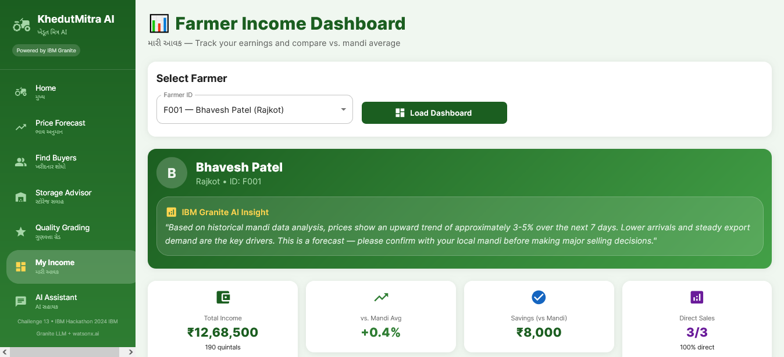
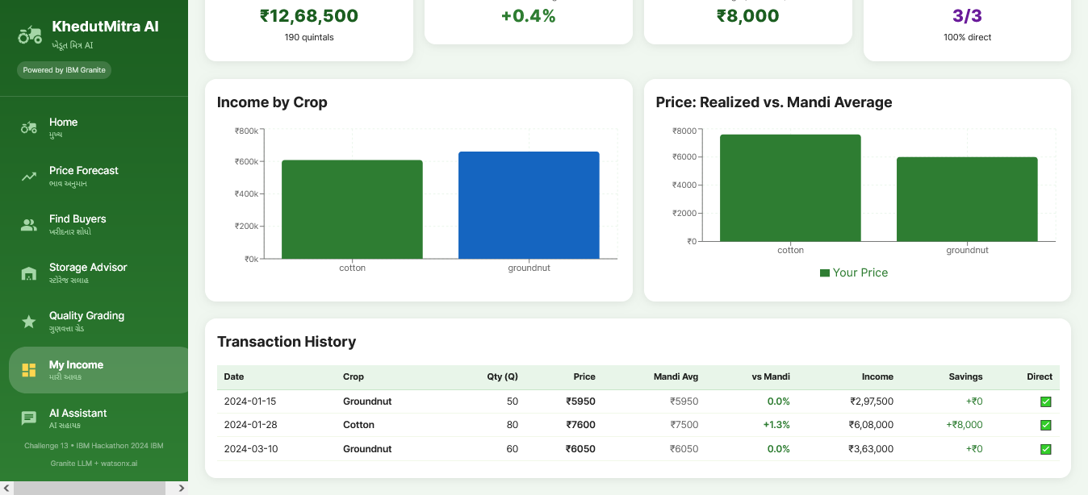
User Income
Farmer income dashboard showing total income, savings vs. mandi average, and direct-sale percentage.
Income-by-crop bar chart, realized vs. mandi price comparison, and a transaction history table.

Slide 19
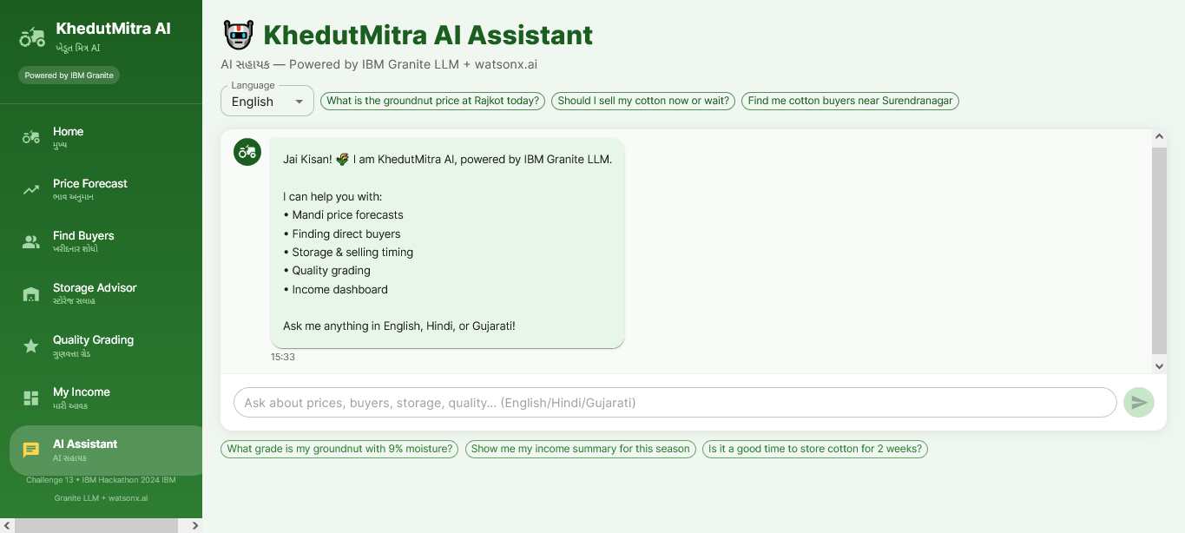
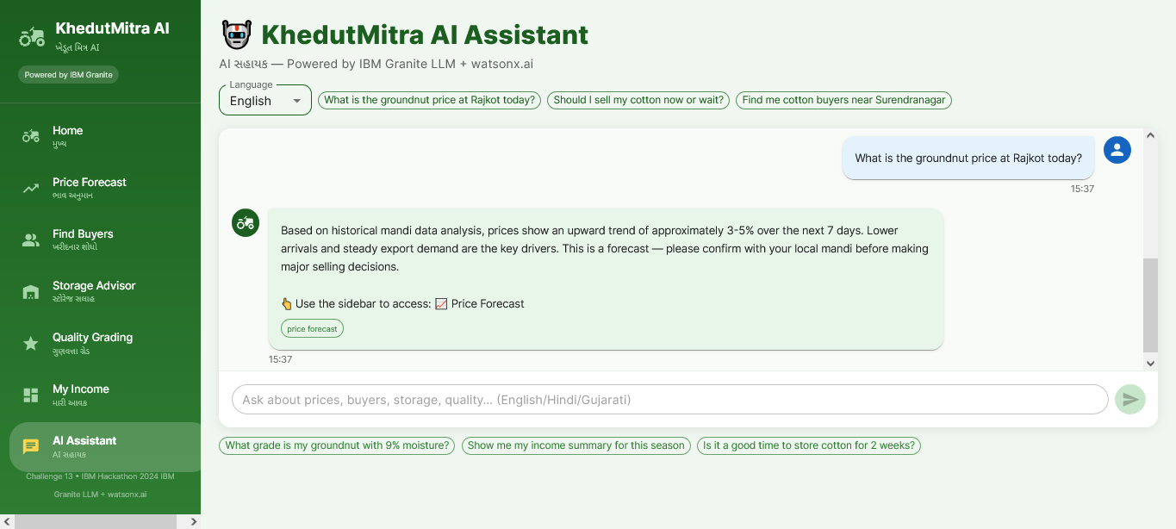
AI Assistant
Multilingual chat assistant welcome screen listing what it can help with (forecasts, buyers, storage, grading, income).
Live chat example showing the assistant answering a groundnut price query with a follow-up action link.

Slide 20
Future Scope
Live Agmarknet/eNAM Integration — Replace sample data with live government mandi price feeds for real-time accuracy across all Gujarat mandis.
Voice & Multilingual Support (Gujarati-first) — Enable farmers to interact via voice in Gujarati and other regional languages, making the platform accessible to non-literate and rural users.
IoT & Warehouse Integration — Connect with smart warehouse sensors to track stored produce condition (moisture, temperature) and refine storage recommendations.
FPO & Cooperative Bulk Selling — Extend buyer-matching to Farmer Producer Organizations for collective bargaining power on larger lots.

Slide 21
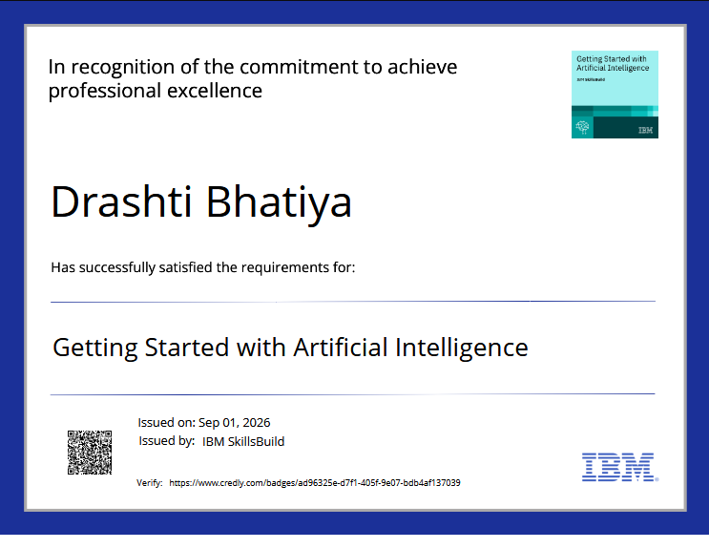
Certificates Earned (credly)

Slide 22
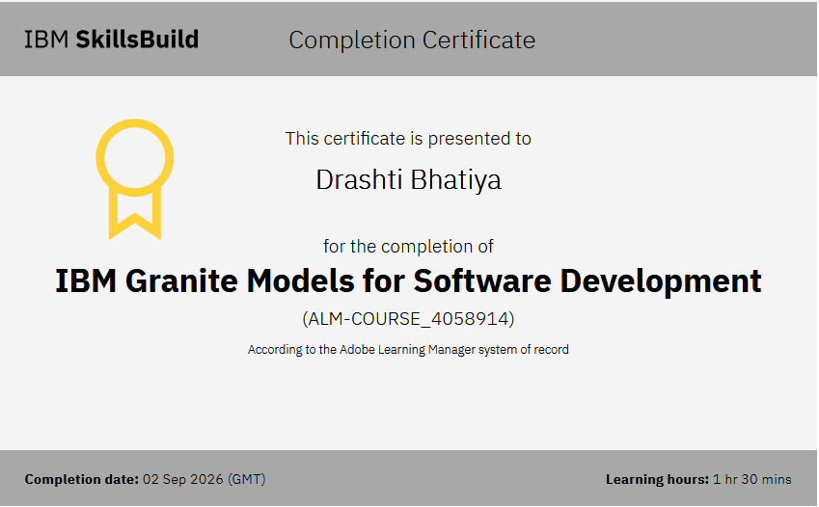
Certificates Earned (IBM BOB)

Slide 23

Thank You
KhedutMitra AI — Empowering every farmer with the market intelligence that big traders already have.

